Slide 1
Module 2 DOCKER

Slide 2
Contents-
Continuous Deployment
Why Docker?
Virtual Machines vs Docker
Container and Image
Docker Client, Docker Daemon, Docker Registry
Docker Pre-requisites
Docker Installation
Docker Commands
Dockerfile

Slide 3
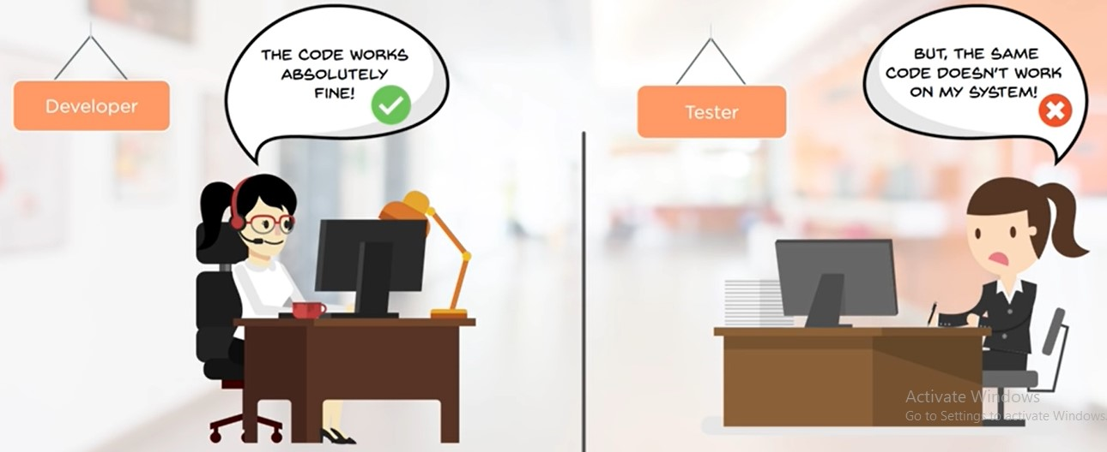
Why Docker?
Before Docker

Slide 4
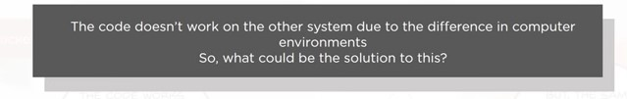
Why Docker?
Before Docker

Slide 5
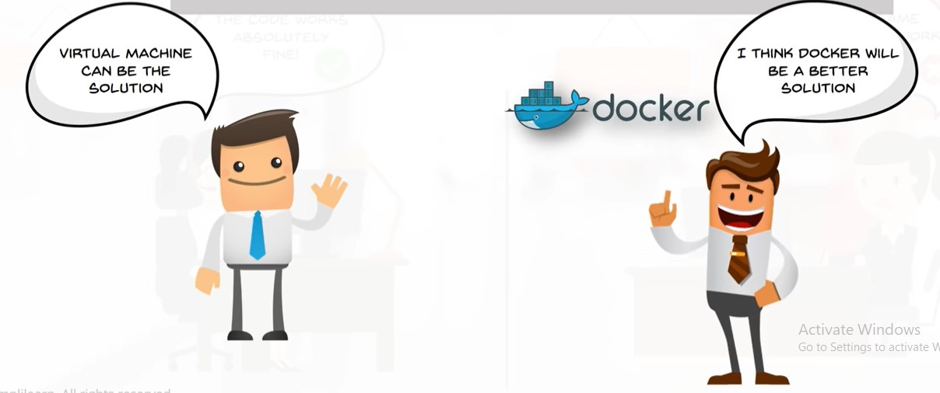
Why Docker?
Solution???

Slide 6
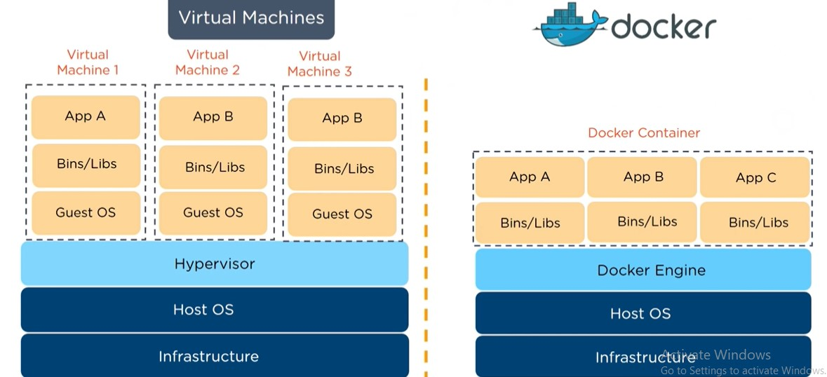
2. Virtual Machines vs Docker

Slide 7
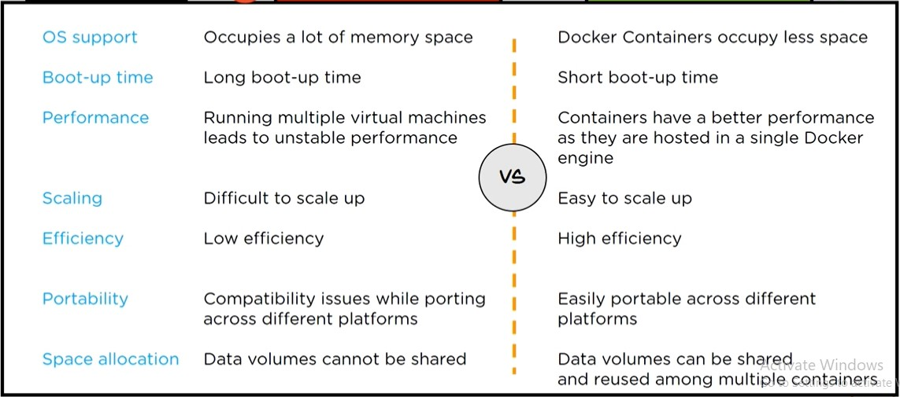
2. Virtual Machines vs Docker
VM Docker

Slide 8
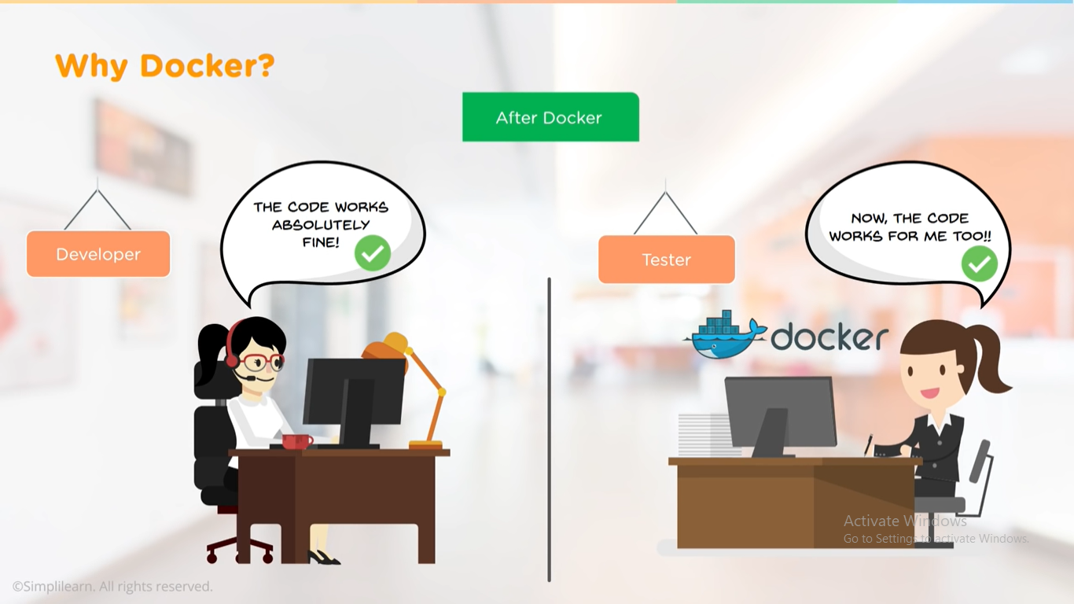
2. Virtual Machines vs Docker
After Docker

Slide 9
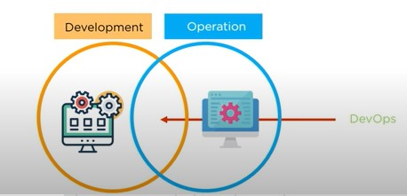
3. Continuous Deployment using Docker

Slide 10
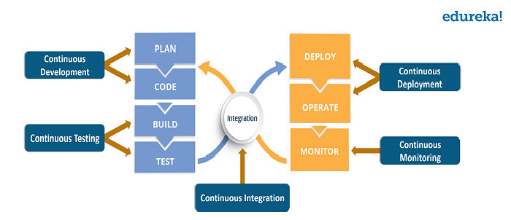
3. Continuous Deployment using Docker

Slide 11
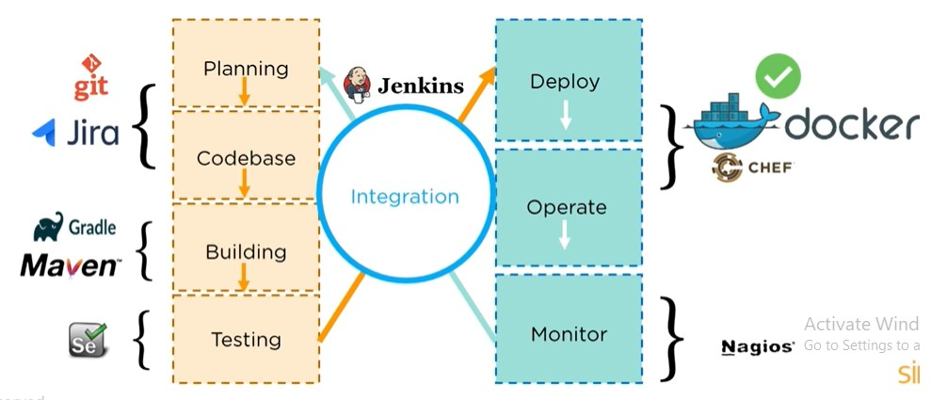
3. Continuous Deployment using Docker

Slide 12
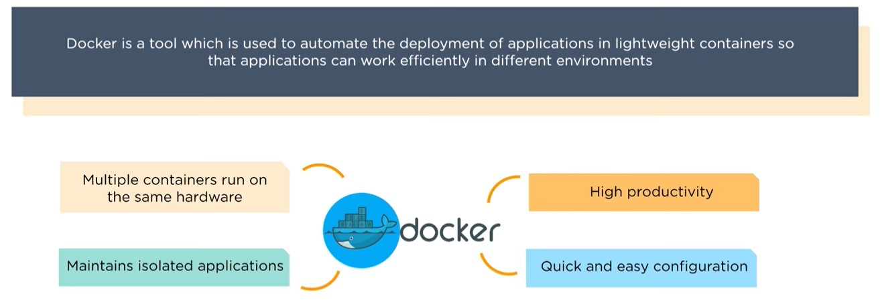
3. Continuous Deployment using Docker

Slide 13
4. Docker Containers and Images
Containers
→OS level Virtualization technology that detaches applications and all of their dependencies from the rest of the system
→a portable executable package which includes applications and their dependencies.

Slide 14
4. Docker Containers and Images
Images
a file used to execute code in a Docker container.
Docker images act as a set of instructions to build a Docker container, like a template.
Docker images also act as the starting point when using Docker.
All of the configuration and instructions to start or stop containers are dictated by the Docker image. Whenever a user runs an image, a new container is created.

Slide 15
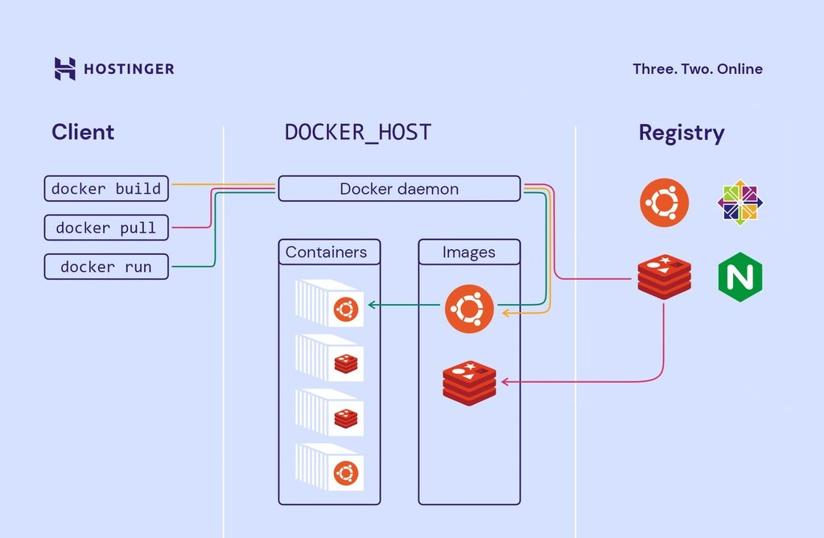
5. Docker Client, Docker Daemon, Docker Registry

Slide 16
5. Docker Client, Docker Daemon, Docker Registry
The Docker architecture consists of four main components along with Docker containers which we’ve covered earlier.
Docker client – the main component to create, manage, and run containerized applications. The Docker client is the primary method of controlling the Docker server via a CLI like Command Prompt (Windows) or Terminal (macOS, Linux).
Docker server – also known as the Docker daemon. It waits for REST API requests made by the Docker client and manages images and containers.

Slide 17
5. Docker Client, Docker Daemon, Docker Registry
Docker images – instruct the Docker server with the requirements on how to create a Docker container. Images can be downloaded from websites like Docker Hub. Creating a custom image is also possible – to do it, users need to create a Dockerfile and pass it to the server. It’s worth noting that Docker doesn’t clear any unused images, so users need to delete image data themselves before there’s too much of it.

Slide 18
5. Docker Client, Docker Daemon, Docker Registry
Docker registry – an open-source server-side application used to host and distribute Docker images. The registry is extra useful to store images locally and maintain complete control over them. Alternatively, users can access the aforementioned Docker Hub – the world’s largest repository of Docker images.

Slide 19
5. Dockerfile
A Dockerfile is text file with instructions to build a docker image
When we run a docker file, a docker image is created
When we run a docker image, a docker container is created

Slide 20
5. Dockerfile
Steps to create a dockerfile –
Create a Dockerfile.
Add instructions in Dockerfile to create a Docker image.
Run Dockerfile to create docker image
Run Docker image to create docker container
Access the application running in docker container

Slide 21
5. Dockerfile
Various Commands-
FROM – used to define the base image on which we will be building.
Syntax – FROM base image
2. ADD- copies files from a source on the host into container’s own filesystem at the set destination.
Syntax – ADD <source> <destination in container>
3. RUN – used to add layers to the base image by installing components.
Syntax – RUN command

Slide 22
5. Dockerfile
Various Commands-
4. CMD – used to run commands on the start of the container. These commands run only when there is no argument specified while running the container
Syntax – CMD [ “executable”]
5. ENTRYPOINT- is used strictly to run commands the moment the container initializes. It run irrespective of whether argument is specified or not
Syntax – ENTRYPOINT [ “executable”]
6. ENV- used to define environment variable in the container runtime
Syntax – ENV key=value

Slide 23
FROM ubuntu
RUN apt-get update
RUN apt-get -y install apache2
ADD . /var/www/html
#CMD apachectl -D FOREGROUND
ENTRYPOINT apachectl -D FOREGROUND
ENV name DevOps
docker tag mydockerfile namratasdocker/mydockerfile
docker login
docker push namratasdocker/mydockerfile

